Slide 1
ESCA TRADING & ENGINEERING SERVICES SNC
Network Engineer Interview Preparation
Comprehensive Technical Revision & Candidate Positioning Deck
Candidate: Muhammad Ainul Fitiri bin Muhammad Jasni
Experience: 7+ Years Enterprise IT Infrastructure, Cabling, IAM/PKI, SOC, Barracuda NGFW & 802.1X EAP-TLS

Slide 2
SECTION 1: PROFILE
Authentic Candidate Journey & Natural Pitch
7+ Year Career Timeline
• 2018-2019: Physical Infrastructure: Falah-Tek & Sistem Integra: Fiber optic cabling, POS hardware setups, and DST Data Centre cabling upgrades.
• 2019-2021 & 2023-2025: Enterprise IAM & Support: DXC Technology (BSP CDIC): Enterprise DR/UAT, hybrid IAM (AD, PingFederate, Azure AD, SAML, PKI certs), Splunk SOC analysis.
• 2021-2023: Security Operations & SIEM: ITPSS & EVYD Technology: Microsoft Sentinel SIEM, WAF, firewalls, Trend Micro XDR, ISO 27001 ISMS Management Rep.
• 2025: Cloud Infrastructure Consulting: Halian International / Propertyfinder UAE: AWS SIEM, VPC routing, security groups, Python automation.
• 2026-Present: Campus Infrastructure Lead: International School Brunei: Primary cybersecurity & infrastructure lead for 1,100+ students, 350+ staff. Barracuda NGFW, VPNs, and 802.1X EAP-TLS Wi-Fi.
Key Strategic Interview Messages
📌 Why Network Engineer?
Networking and security are inseparable. A network that isn't secure is a liability. My incident engineering background ensures I build resilient, high-availability networks with zero-trust segmentation and root-cause troubleshooting.
📌 Degree vs. Diploma
Level 5 Diploma + ITIL v4 backed by 7 continuous years of hands-on production engineering across enterprise data centers, DXC, and ISB. Real-world ownership of firewalls, VLANs, and PKI; eager to sit CCNA vendor exams.
📌 Bruneian Local Priority
Physically in Brunei, immediately deployable on-site for emergencies and maintenance; familiar with UNN telecommunications, local corporate culture, and Brunei PDPO regulations.

Slide 3
SECTION 2: REQUIREMENTS MATCH
ESCA Job Requirements Alignment Matrix
5+ Years Network Experience
7+ years continuous enterprise experience from physical cabling to campus perimeter firewalls.
TCP/IP & Routing Protocols
Daily administration of IP subnets, VLANs, 802.1Q trunking, NAT/PAT, OSPF, and Zero Trust segmentation.
Firewalls, IDS/IPS & VPNs
Daily operations of Barracuda NGFWs, AppID, SSL inspection, site-to-site IPsec & remote SSL VPNs.
Network Monitoring & Tools
Packet captures with Wireshark & tcpdump; log correlation across Sentinel, Splunk, and Elasticsearch SIEM.
Hardware Installation & Maintenance
Physical and logical management: rack installs, switch provisioning, cabling, scheduled firmware upgrades.
Vulnerability & Incident Response
Nessus vulnerability assessments, ISO 27001 audit leadership, and dynamic switch-port incident containment.

Slide 4
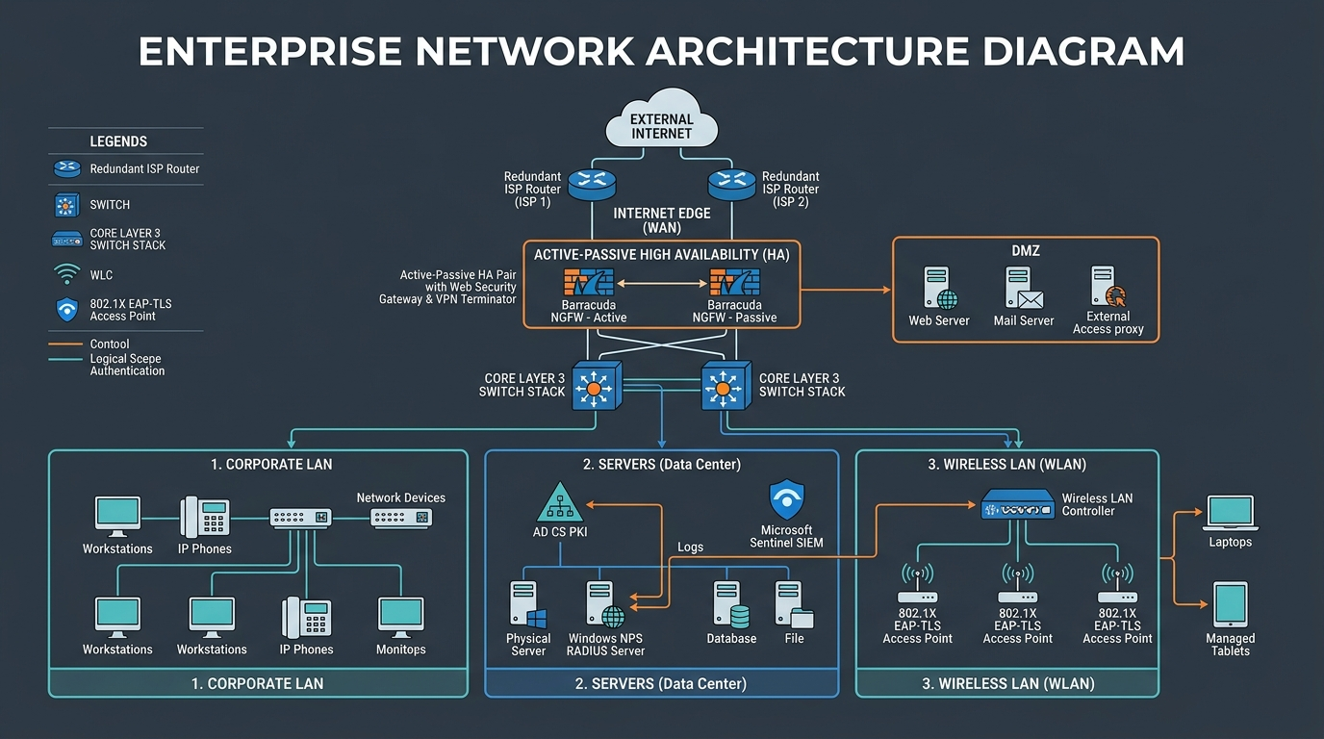
SECTION 3: ARCHITECTURE
Enterprise Network Perimeter Architecture
Key Architectural Elements
• Dual WAN Edge: Redundant ISP connections with automatic failover and state tracking.
• Active-Passive HA Pair: Barracuda NGFW cluster with synchronized connection tables and virtual IPs (VIP).
• Core L3 Switch Stack: Wire-speed Inter-VLAN routing via SVIs; OSPF Area 0 backbone routing.
• Demilitarized Zone (DMZ): Isolated zone for public web, proxy, and inbound services.
• Data Center Segment: Protected servers: AD CS PKI, Windows NPS RADIUS, and Microsoft Sentinel SIEM.
• Secure Wireless Edge: WLC and 802.1X EAP-TLS APs connecting Windows laptops and supervised iPads.

Slide 5
SECTION 4: FIREWALL
Barracuda Next-Gen Firewall & Web Security Gateway
Inspection Pipeline
Ingress uRPF -> State Table -> DNAT -> Top-to-Bottom Policy Evaluation -> AppID -> IPS Engine -> SNAT -> Egress Routing.
SSL/TLS Deep Inspection
Terminates TLS via Enterprise Subordinate CA; decrypts and inspects payload; bypasses banking, medical, and certificate-pinned apps.
Web Security Gateway
URL category filtering (phishing/adult/gambling); enforces YouTube-Restrict headers and Google SafeSearch; QoS traffic shaping for VoIP.
Live CLI Diagnostics
phion sessions, phion connection list | grep <ip>, tcpdump -i eth0 host <ip> and port 443 -nn, and Live Log analysis.

Slide 6
SECTION 5: VPN
Secure VPN Tunnels: Site-to-Site & Remote Access
IPsec Site-to-Site Mechanics
• IKE Phase 1 (ISAKMP SA): Authenticates peers and creates management tunnel. Must match: AES-256-GCM, SHA-256, DH Group 14/19, PSK/Cert, Lifetime (28800s). UDP 500 / 4500 (NAT-T).
• IKE Phase 2 (IPsec SA): Encrypts user payload via ESP (Protocol 50). Perfect Forward Secrecy (PFS) ensures new DH key per rekey. Proxy IDs / subnets must match exactly.
• Route-Based VTI: Creates virtual tunnel interface (vti0); supports dynamic routing protocols (OSPF, BGP) across the tunnel.
• MSS Clamping: Clamp TCP MSS to 1360-1400 to prevent fragmentation drops caused by 50-70 byte IPsec headers.
Troubleshooting Diagnostic Rules
⚠️ NO_PROPOSAL_CHOSEN: Phase 1 encryption, hash, or DH group mismatch. Align crypto suites.
⚠️ AUTHENTICATION_FAILED: Mismatched Pre-Shared Key (PSK) or peer IP typo.
⚠️ PEER_NOT_RESPONDING: UDP 500 or UDP 4500 blocked upstream by ISP/firewall.
⚠️ PROPOSAL_MISMATCH (Phase 2): Phase 2 ESP encryption or PFS mismatch.
⚠️ INVALID_TRAFFIC_SELECTOR: Proxy ID / subnet mismatch (e.g. /24 on Site A vs /16 on Site B).
⚠️ Client-to-Site VPN: Entra ID MFA via SAML/RADIUS; split-tunnel for bandwidth vs full-tunnel for security.

Slide 7
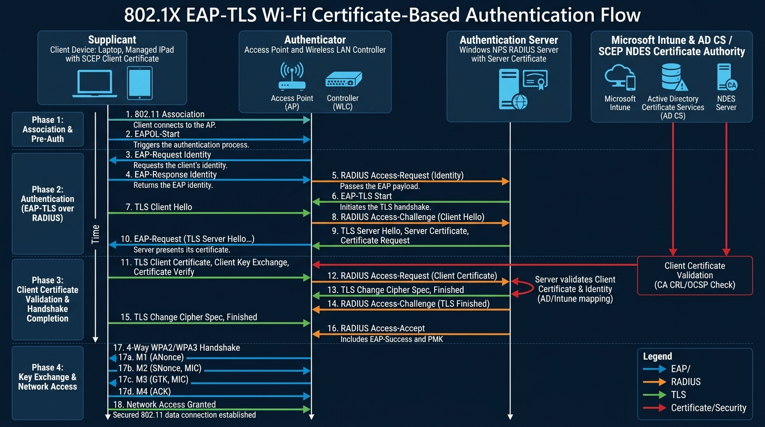
SECTION 6: WIRELESS PERIMETER
802.1X Certificate-Based EAP-TLS Authentication
EAP-TLS Deployment Pillars
• Supplicant: Managed Windows laptops and iPads with SCEP client certs locked in TPM/Secure Enclave.
• Authenticator: Access Points & WLC forwarding 802.1X EAPOL frames to RADIUS via UDP 1812.
• Auth Server: Windows NPS RADIUS server validating client certs and returning dynamic VLAN IDs.
• PKI & Intune: AD CS CA with SCEP/NDES pushing certs silently via Intune MDM profiles.
• Immune to Phishing: Zero password transmission; completely immune to Evil Twin and credential theft attacks.

Slide 8
SECTION 7: NETWORKING CORE
Layer 2 Switching, Security & OSPF Routing
802.1Q VLANs & STP
4-byte tag (VID 12-bit). RSTP (802.1w) sub-second convergence. BPDU Guard shuts unauthorized switches; Root Guard preserves Root Bridge.
Layer 2 Defense Suite
DHCP Snooping blocks rogue DHCP; Dynamic ARP Inspection (DAI) prevents MitM poisoning; IP Source Guard stops IP spoofing; Port Security limits MACs.
Inter-VLAN Routing
Router-on-a-Stick (sub-interfaces with dot1q) vs Layer 3 Switch SVI (wire-speed ASIC routing via 'ip routing').
OSPF Adjacency & MTU
Down -> Init -> 2-Way -> ExStart -> Exchange -> Loading -> Full. Routers stuck in ExStart indicates MTU Mismatch on DBD packets!

Slide 9
SECTION 8: OPERATIONS
Monitoring, Packet Analysis & Firmware Runbook
OSI Systematic Troubleshooting
Layer 1 (optics/cables/CRC) -> Layer 2 (duplex/MAC/STP/VLAN) -> Layer 3 (IP/gateway/routes) -> Layer 4 (ports/firewall/RST) -> Layer 7 (DNS/TLS).
Wireshark Filter Cheatsheet
tcp.flags.syn==1 (initiation), tcp.flags.reset==1 (dropped/reset), tcp.analysis.retransmission (packet loss/drops), tcp.analysis.zero_window (buffer exhaustion).
Firmware Upgrade Runbook
Pre-checks: verify SHA-256 hash, CAB change approval, TFTP config backup. Execution: secondary partition, HA passive-first failover. Rollback if routes fail after 20 mins.
Nessus & Incident Containment
Credentialed vulnerability scans; disabling Telnet/HTTP/SNMPv1; quarantining compromised ports via 802.1X / switch port shutdown.

Slide 10
SECTION 9: CLOSING
STAR Behavioral Scenarios & Strategic Questions
Key STAR Stories
⭐ Story 1: ISB EAP-TLS Wi-Fi Overhaul
Eliminated shared WPA2 passwords across 1,100+ students and 350+ staff using Intune SCEP, NPS RADIUS, and Barracuda WSG. Reduced Wi-Fi tickets by 40%.
⭐ Story 2: Peak-Hour Outage Diagnosis
Diagnosed sudden WAN collapse to a malware-driven UDP flood from a rogue host; isolated switch port, cleared firewall states, restored network in 12 mins.
⭐ Story 3: ISO 27001 Certification
Served as ISMS Rep at EVYD; implemented firewall, WAF, and SIEM controls; achieved zero major non-conformities during audit.
Strategic Questions for ESCA
❓ 1. Infrastructure Vendors: What is ESCA's primary hardware ecosystem—Cisco, Fortinet, Aruba, or multi-vendor? How are you handling SD-WAN?
❓ 2. Upcoming Projects: What major network overhauls or data center migrations are scheduled in the next 6-12 months?
❓ 3. Security Posture: Are clients transitioning toward Zero Trust segmentation, 802.1X certificate authentication, or identity-aware firewalls?
❓ 4. Professional Growth: How does ESCA support network engineers in pursuing advanced vendor certifications (e.g. CCNA/CCNP, NSE)?

